Slide 1
EnrollHub
Team MAAD
Aboubacar Sidik Diakite, Melvin Sierra, Devin Munoz, Alexandr Voronovich

Slide 2

What and Why
A website application that allows user type student ID and send a query that will bring the classes enrolled in by the student in a specific semester and all the class info such as schedule and the teacher and more etc..
Our goal is to provide a streamlined and user friendly website so that users can have a good experience using our product

Slide 3
How and the Journey Map
Account types:
guest (not signed in/view only)
In order to access the website, they must sign in or create an account
User (ability to get Students’ enrollment, classes info, teachers etc..)
Must be signed in and authenticated
admin (ability to control, update, add, remove, and/or swap courses for every student in the database)
Limited amount of users that have these capabilities
Serves as the registrar

Slide 4
How and the Journey Map (cont.)
Login/create account page → either enter login credentials or enter information such as name, sex, DOB, email address, and major (user is automatically assigned a random ID) → search for specific course ID and do any of the available actions or view current schedule → …

Slide 5
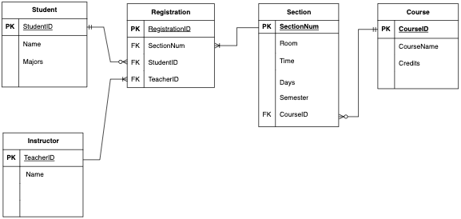
Relational Data Model

Slide 6




The Stack
MySQL:
Description: MySQL is a popular open-source relational database management system.
Role: Used to store and manage the data for the student enrollment application,
including tables for students, courses, professors, and enrollments.
Benefits: Offers reliability, scalability, and ease of use for handling complex queries and
large datasets.
Node.js:
Description: Node.js is a JavaScript runtime built on Chrome's V8 JavaScript engine.
Role: Handles the server-side logic of the application, including API endpoints for creating,
reading, updating, and deleting (CRUD) operations on the database.
Benefits: Provides a non-blocking, event-driven architecture suitable for scalable and efficient applications.

Slide 7
Member Roles
Project Manager
Frontend Developer: Melvin Sierra
Backend Developer: Alexandr Voronovich
Database Administrator (DBA) Aboubacar Sidik Diakite
Quality Assurance (QA) Engineer

